Slide 1
Evaluation of att face data set using neural networks
Kiran Gavini

Slide 2
Code
Data = imageSet('orl_faces','recursive');
a=1; % pixels modified into one single row for each image
b=1; % no of images in each folder
targets=zeros(100,20); % Create binary classification for output
for j=1:20 % assign number of folders
for i=1:5 %Assign number of images
X= read(Data(j),i);
for c=1:92 % No of coloums in an image
for r=1:112 % No of rows in an image
y(b,a)=X(r,c); % Input data
a=a+1; %Step increment of pixel data
end;
end;
targets(b,j)=1;
b=b+1; % Increment to the next image
a=1; % Set step size to 1 for new image
end;
end;

Slide 3
.
inputs=double(y');
targets=targets';
% Create a Pattern Recognition Network
hiddenLayerSize = 10;
net = patternnet(hiddenLayerSize);
% Set up Division of Data for Training, Validation, Testing
net.divideParam.trainRatio = 70/100;
net.divideParam.valRatio = 15/100;
net.divideParam.testRatio = 15/100;
% Train the Network
[net,tr] = train(net,inputs,targets);
% Test the Network
outputs = net(inputs);
errors = gsubtract(targets,outputs);
performance = perform(net,targets,outputs)
% View the Network
view(net)
figure, plotperform(tr)
figure, plottrainstate(tr)
figure, plotconfusion(targets,outputs)
figure, ploterrhist(errors)

Slide 4
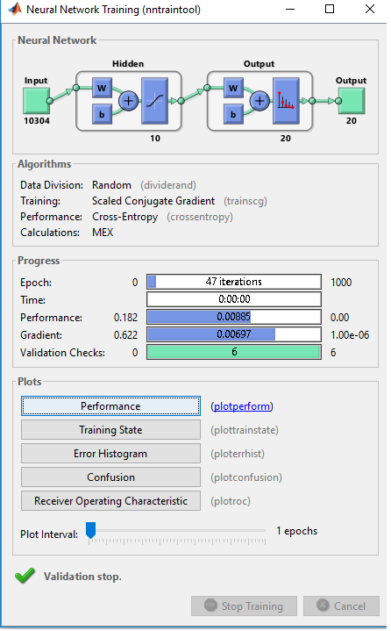
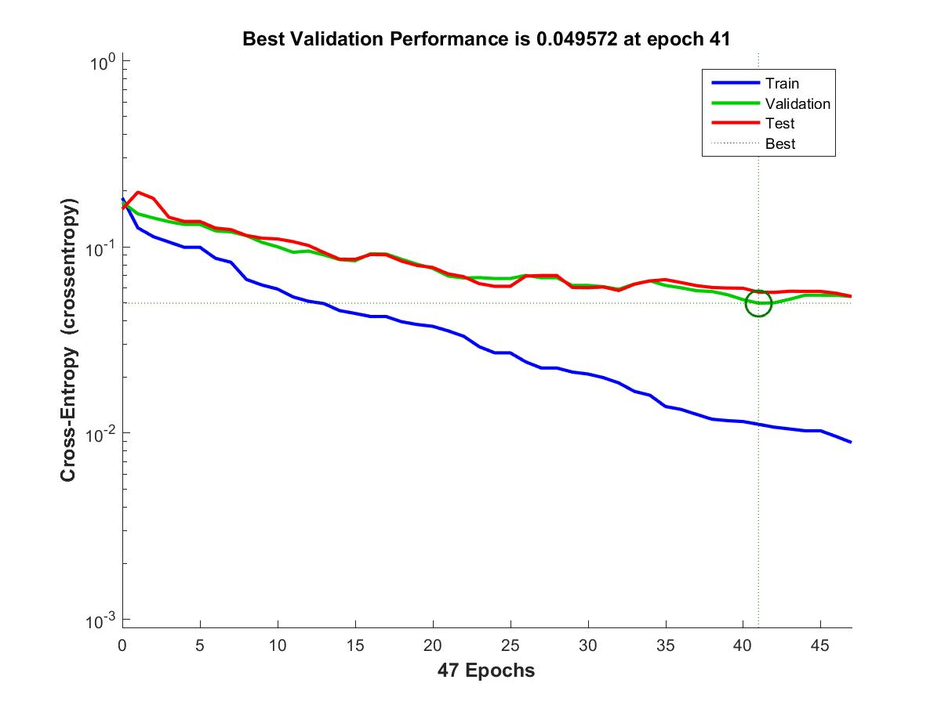
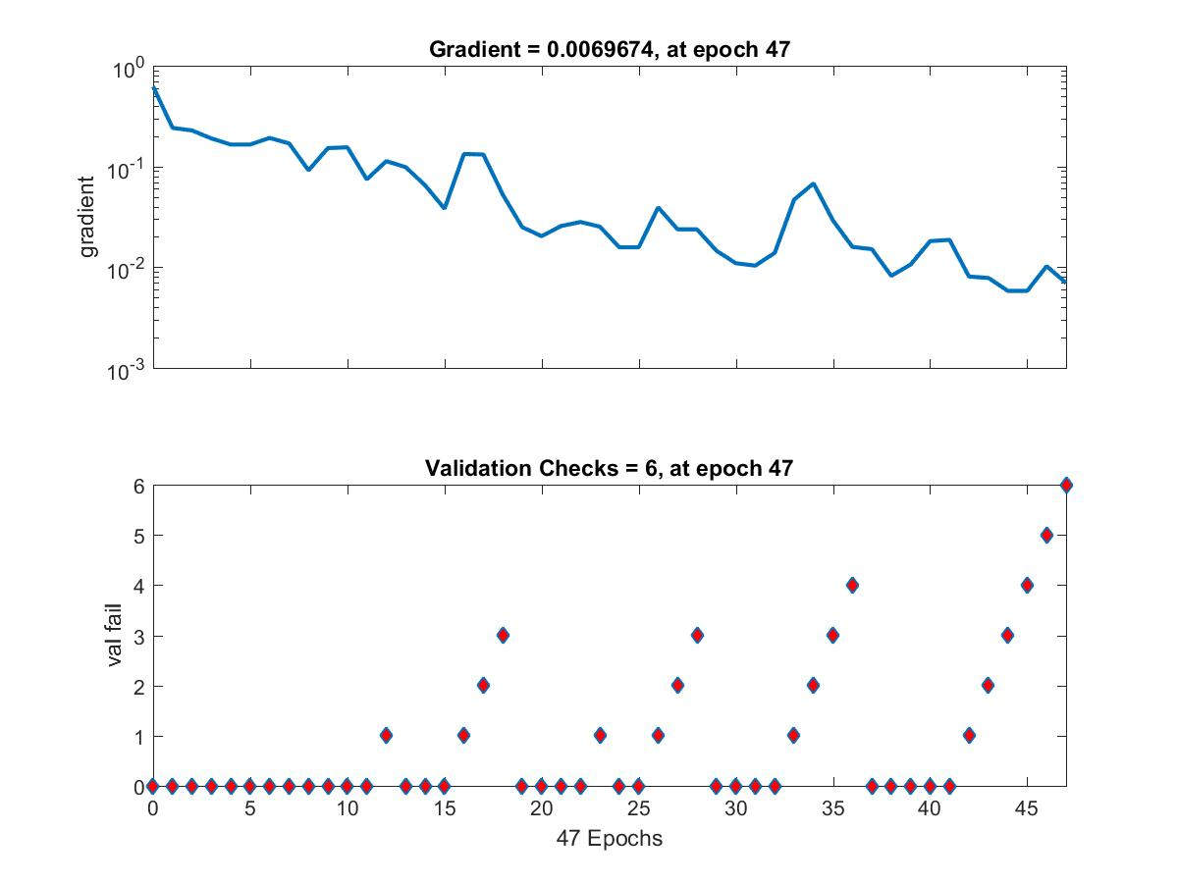
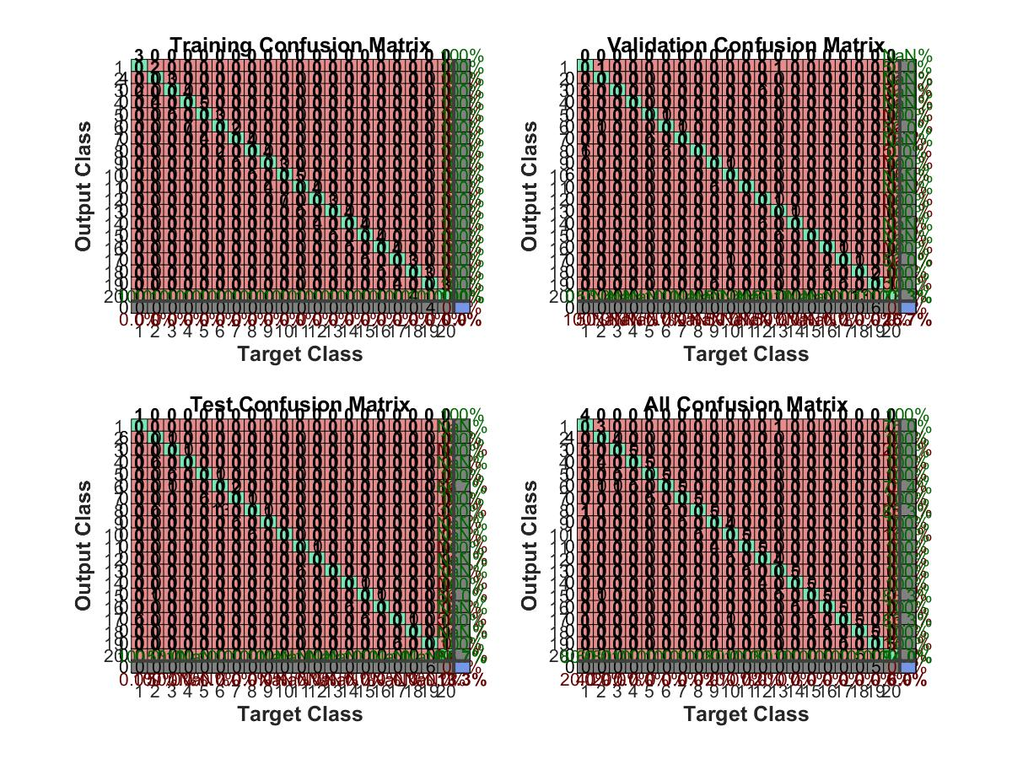
Training with 10 hidden layers

Slide 5
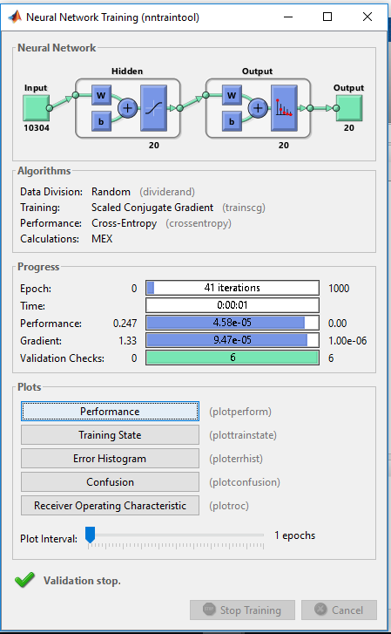
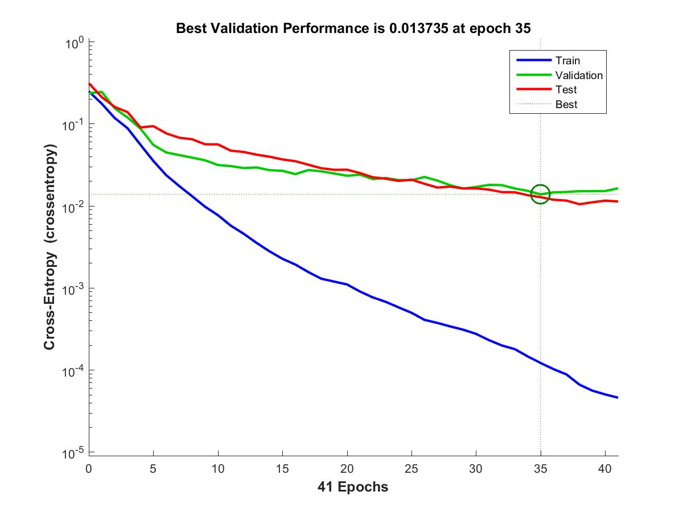
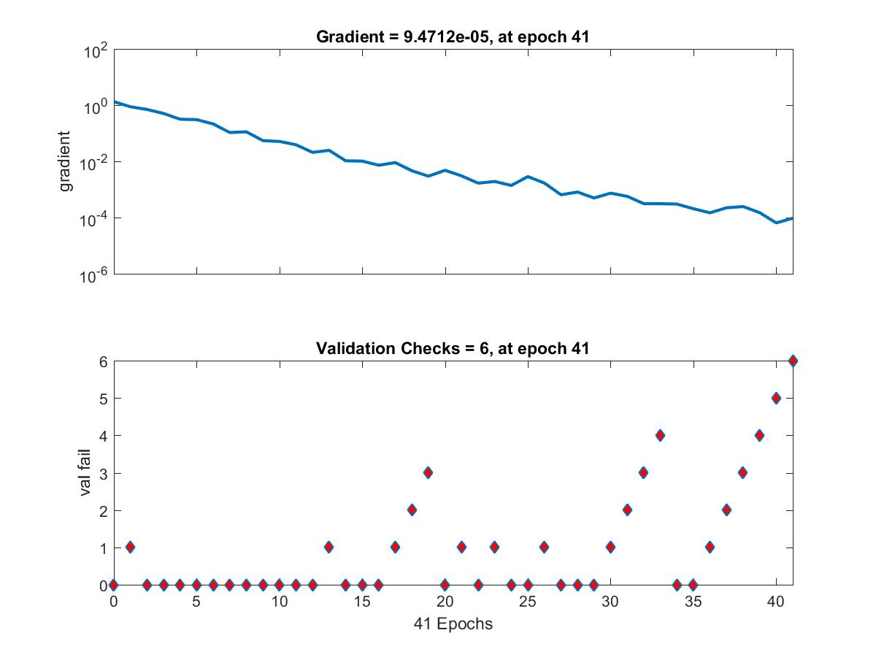
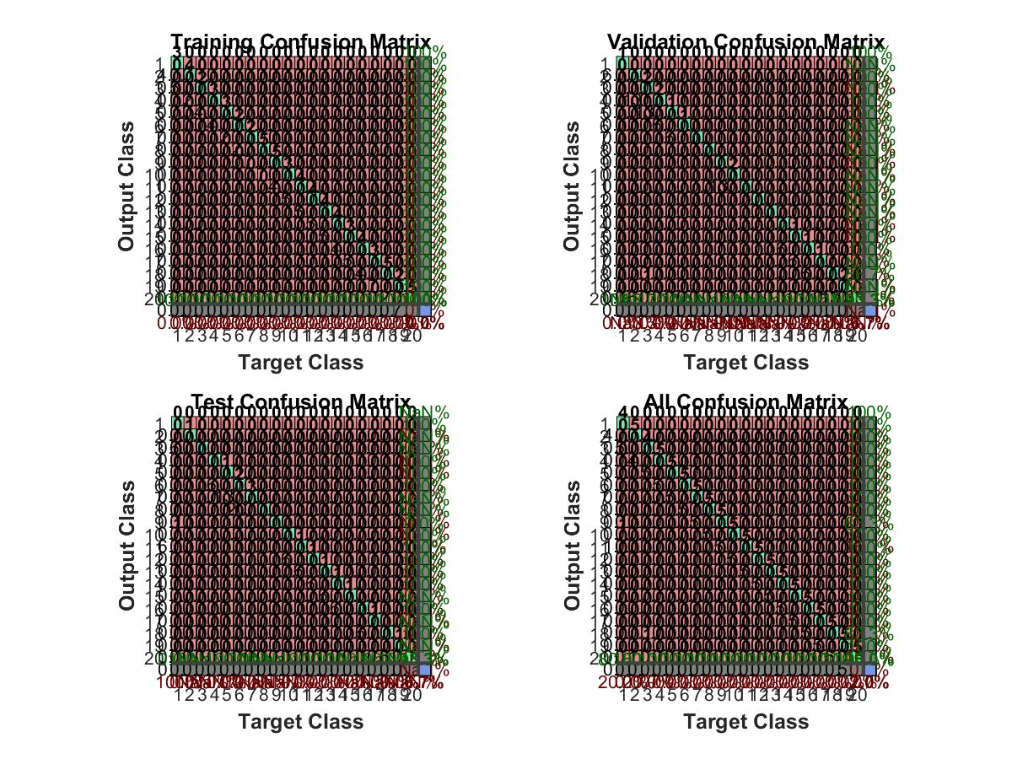
Training with 20 hidden Layers

